Slide 1
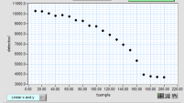
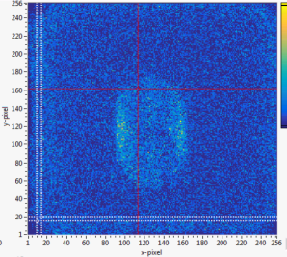
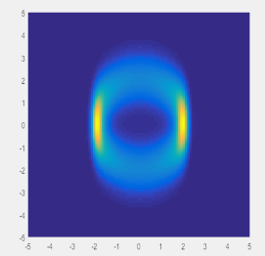
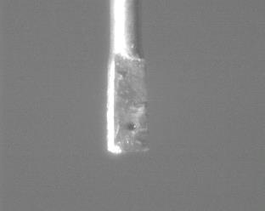
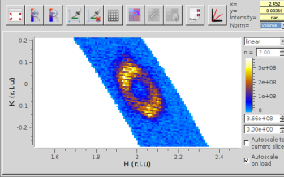
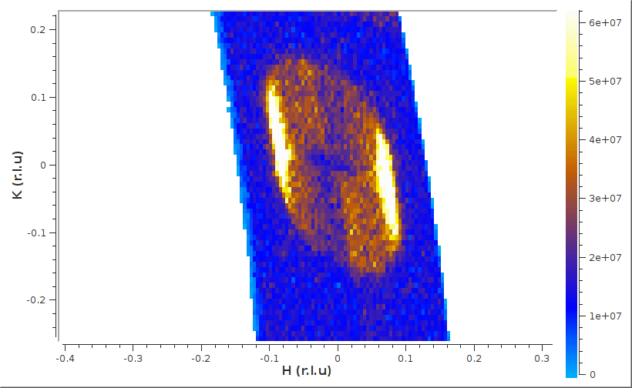
Circular-magnetic k-vector observed on a 0.02 mm³ crystal at HFIR HB-3A
Users: Kathryn Ross
Colin Sarkis
James Nielson
(Colorado State University)
Local contact: Huibo Cao (QCMD)
With 5 x 5 cm 2D Anger camera, we mapped out a circular k-vector magnetic order.
T_{N}
Seen on 2D detector
Simulation
1.58 mm
Crystal: 0.33 x 0.33 x 0.2 mm (0.2 mg)
The circular distribution of k-vectors definitively confirms Fe₃PO₇ to have a “partially ordered” antiferromagnetic (AFM) helical state. One candidate for such a state is a short-range ordered AFM Skyrmion phase.
Sliced in HK-plane with MantidPlot

